Slide 1


Brand Marketing Strategy
FOR MELODY TRAVELS COMPANY

Slide 2
Agenda
Executive Summary
Vision, Mission and Goals
Unique Value Proposition
Marketing Targets
Buyer Personas
Key Marketing Messages
Budget Plan
Strategy Calendar

Slide 3
Vision, Mission and Goals
Vision
Mission
Goals
Melody Travel offers unforgettable journeys, blending comfort, culture, and adventure to create harmonious travel experiences worldwide
"Melody Travel is dedicated to providing personalized, seamless travel experiences that inspire and enrich every journey."
List down short-term and long-term goals that will help translate your vision and mission into action.

Slide 4
Branding Elements:
- Unique Value Proposition: "Your Gateway to Unforgettable Journeys."
- Service Promise: To deliver personalized, safe, and extraordinary travel experiences.
- Desired Customer Loyalty: Achieve a high level of repeat customers through exceptional service and exclusive travel offers.

Slide 5
Marketing
Targets
- Social Media Analysis: Focus on Facebook and Instagram for targeted ads, with a secondary focus on LinkedIn for corporate travel packages.
- Channel Strategy:
- Facebook: Daily posts, target ads.
- Instagram: Daily stories and posts, influencer partnerships.
- LinkedIn: Weekly updates, B2B targeting.
- Main Goals: Increase brand awareness, drive traffic to the website, and boost conversions.
- Main Content Themes: Travel tips, destination highlights, customer testimonials, and promotional offers.
- Posting Frequency: Facebook & Instagram - Daily; LinkedIn - Weekly.

Slide 6
SWOT Analysis
Strengths | Weaknesses | Opportunities | Threats
Strong brand identity, high-quality customer service, diverse travel packages. | Limited physical presence, high dependency on online channels. | Expanding into emerging markets, developing new eco-friendly travel packages. | Economic downturns, political instability in key regions, competition from established brands.

Slide 7
Increase Brand Awareness: Establish the company as a leading travel agency in Egypt by promoting its unique services and travel packages through various marketing channels. | Attract Local and International Tourists: Create targeted campaigns to attract both Egyptian and international travelers, highlighting the diverse experiences Egypt has to offer, from cultural heritage to natural wonders.
Boost Online Presence: Strengthen the company's online visibility through social media, SEO, and digital advertising, ensuring the brand reaches a wider audience and converts leads into bookings. | Enhance Customer Engagement and Loyalty: Develop loyalty programs and personalized offers to retain customers and encourage repeat bookings, enhancing overall satisfaction.
Goals and Objectives

Slide 8
Promote Sustainable and Eco-Friendly Tourism: Advocate for responsible tourism practices by promoting eco-friendly tours and supporting local communities, aligning the company’s values with global sustainability trends. | Increase Sales and Revenue: Achieve a measurable increase in bookings and revenue by optimizing marketing strategies, offering competitive pricing, and focusing on seasonal promotions.
Showcase Egypt’s Lesser-Known Destinations: Highlight off-the-beaten-path destinations within Egypt to diversify travel experiences and attract adventurous travelers seeking unique and authentic experiences. | Partnerships and Collaborations: Build strategic partnerships with hotels, airlines, and local tour operators to create attractive travel packages and expand the company’s service offerings.
Goals and Objectives

Slide 9
Digital Marketing Strategy for "Melody Travels"
Social Media Marketing:
Create official pages on social media platforms such as Facebook, Instagram, Twitter, and YouTube.
Post engaging and diverse content including images, videos of tourist destinations, special offers, and customer testimonials.
Utilize features like Stories and live posts to interact with followers and provide exclusive content.
Use popular hashtags to increase reach, such as #TravelTourism #BestDeals #VacationPackages.
Search Engine Optimization (SEO):
Optimize the company website with relevant keywords related to travel and tourism services to rank higher in search engine results.
Implement both on-page and off-page SEO strategies, including content creation, meta tags, and backlinking.
Focus on local SEO by targeting keywords like "best travel agency" or "tour packages" in specific locations.
Notes:
Ahlam

Slide 10
Search Engine Optimization (SEO)
Optimize the company website with relevant keywords related to travel and tourism services to rank higher in search engine results.
Implement both on-page and off-page SEO strategies, including content creation, meta tags, and backlinking.
Focus on local SEO by targeting keywords like "best travel agency" or "tour packages" in specific locations.
Notes:
Ahlam

Slide 11
Email Marketing
Social Media
Create official pages on social media platforms such as Facebook, Instagram, Twitter, and YouTube.
Post engaging and diverse content including images, videos of tourist destinations, special offers, and customer testimonials.
Utilize features like Stories and live posts to interact with followers and provide exclusive content.
Use popular hashtags to increase reach, such as #TravelTourism #BestDeals #VacationPackages.
Build and maintain an email list by offering newsletters, special deals, and travel guides to customers.
Segment email campaigns based on customer interests, such as family vacations, luxury getaways, or adventure tours.
Send personalized emails with exclusive offers, upcoming tour packages, and destination highlights to increase customer engagement.
Notes:
Ahlam

Slide 12
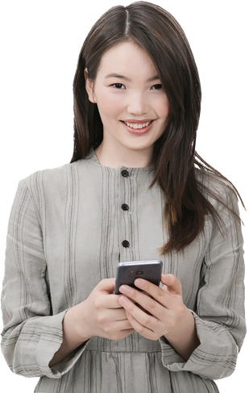
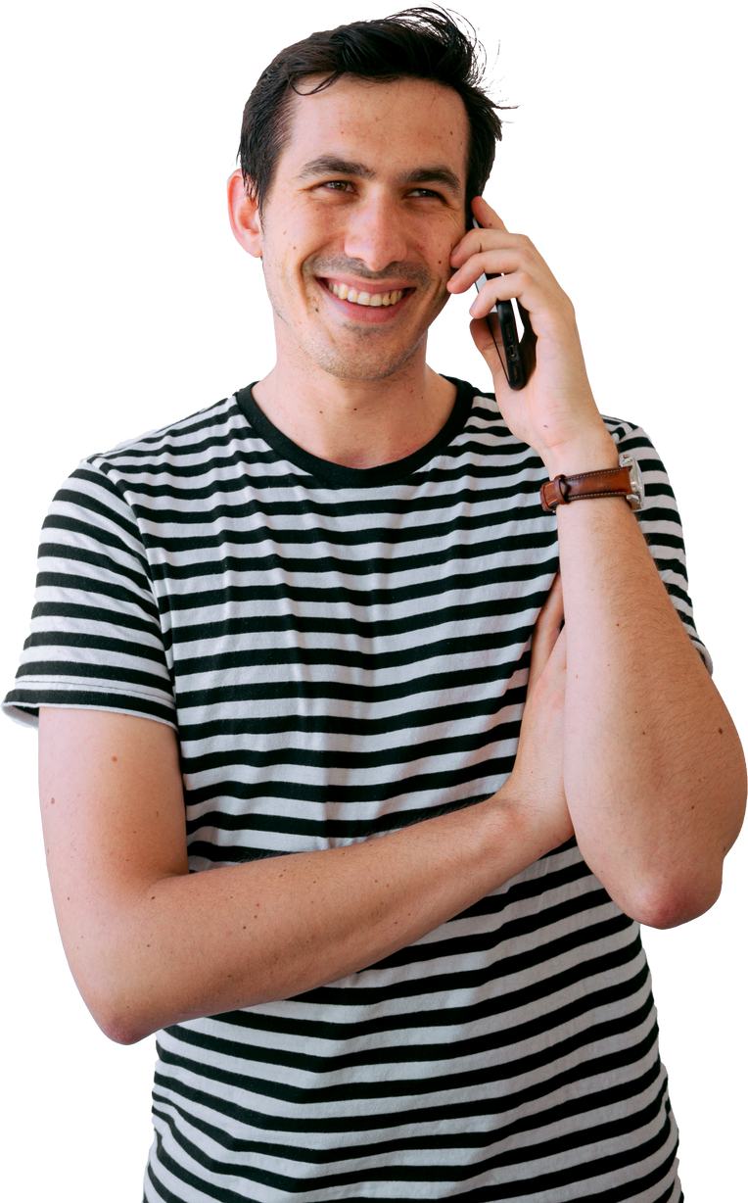
Buyer Personas
Buyer Persona 1
Buyer Persona 2
sa
Sara Samir
Ahmed mostafa
25 years
35 years
doctor
Engineer
Passionate about traveling and exploring new places.
He enjoys visiting new places and learning about their landmarks.
Notes:
Ahlam

Slide 13
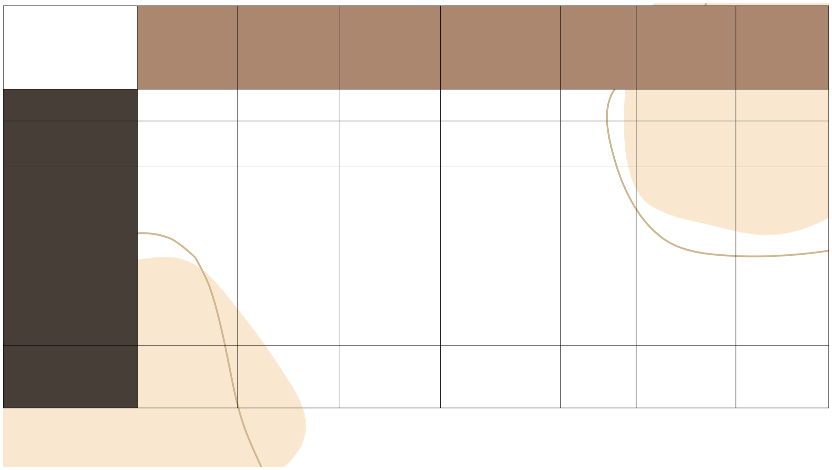


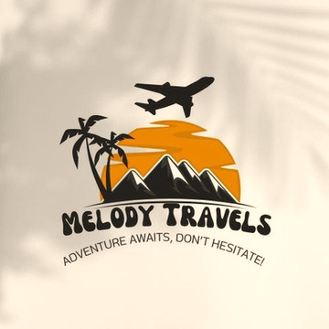
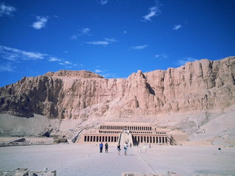
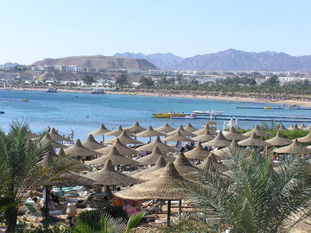
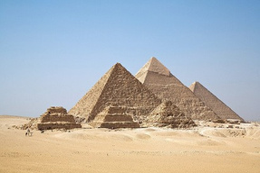
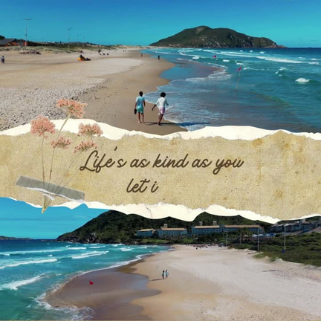
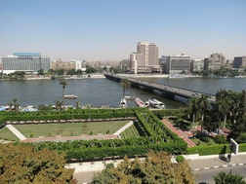
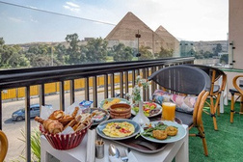

Monday
Tuesday
Wednesday
Thursday
Friday
Saturday
Sunday
Platform \ Time
11:00 pm
12:00 pm
8::00 pm
5:00 pm
09:00
11:00 pm
12:00 pm
Platform
facebook
instgram
reels-facebook
e-mail marketing
instgram
tiktok
post-facebook
1️⃣ **الأقصر وأسوان:**
متحف مفتوح وسط المعابد القديمة والآثار التاريخية. استمتع برحلة نيلية ساحرة وزيارة معابد الكرنك وفيلة، وجرب الحياة النوبية البسيطة والمريحة! 🚤🌅
2️⃣ **شرم الشيخ:**
جنة الغواصين وعشاق البحر! 🌊🏖️ من السباحة في المياه الزرقاء الصافية، إلى رحلات السفاري في الصحراء واستكشاف الحياة البحرية في محمية رأس محمد، شرم الشيخ وجهة متكاملة للاسترخاء والمغامرة.
🏖 Relax on Elalealamayn
🎯 السفر مغامرة، بس الاستعداد ليها بيخليها أكتر متعة وأمان! شاركنا نصائحك المفضلة للسفر في التعليقات! 😎
#نصائح_السفر #السياحة_الداخلية #Melody_Travel #سفر_آمن #استعد_لرحلتك
Beaches
Explore Egypt’s breathtakin g history, stunning landscapes , and vibrant culture with Melody Travel
Feel the soft sand between your toes and let the waves wash your worries away. Whether you’re looking for adventure or relaxation, our curated coastal trips offer the perfect getaway. aleilm ealamayn
Pyramids of Giza: Stand before the timeless wonders of the ancient world 🏺.
Content
EXPLOR ANCIENT Egypt
Visual
Notes
melody travels is your best choice
Goals
#ExploreWithMelody #TravelGoals #SustainableTourism #UnforgettableJourneys
Notes:
Ahlam

Slide 14
Questions Analysis
1. What do you offer? Customized and luxurious travel experiences.
2. Why was the business created? To cater to the demand for personalized and unforgettable travel experiences.
3. Who provides the services? A team of experienced travel consultants, tour guides, and customer support staff.
4. When are the services provided? Available year-round, with special offers during peak travel seasons.
5. Who are the services for? High-income individuals and young professionals aged 25-55.
6. Where are the services provided? Primarily online, with physical offices in Cairo and Dubai.
7. How are the services provided? Through an easy-to-use online platform, supported by a dedicated team of experts.

Slide 15
Annual Business Goals (SMART)
- Specific: Increase website traffic by 30% within the first 6 months.
- Measurable: Achieve 2,000 bookings in the first year.
- Achievable: Expand to at least two new markets within a year.
- Realistic: Launch three new travel packages by the end of the year.
- Time-Based: Reach 50,000 social media followers in the first 6 months.

Slide 16
COMPANY OBJECTIVES OVER TIME:
- 3 Months: Establish a strong social media presence and reach 10,000 followers.
- 6 Months: Launch a successful digital marketing campaign, achieving 500 bookings.
- 9 Months: Expand to a new market, potentially Gulif area
- 12 Months: Achieve 2,000 bookings, expand to two new markets, and introduce new travel packages.

Slide 17


Channels
🏖️ Relax on Elalealamayn
Beaches
Feel the soft sand between your toes and let the waves wash your worries away. Whether you’re looking for adventure or relaxation, our curated coastal trips offer the perfect getaway.
aleilm ealamayn
✨ Special Offers Available! ✨
Contact us now to learn more about our exclusive travel packages.
📞 Call us: +123 456 7890
💻 Visit our website: www.melodytravel.com

Slide 18
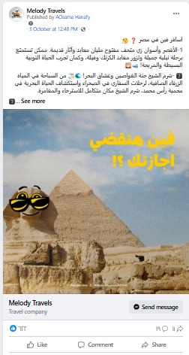

Channels

Slide 19
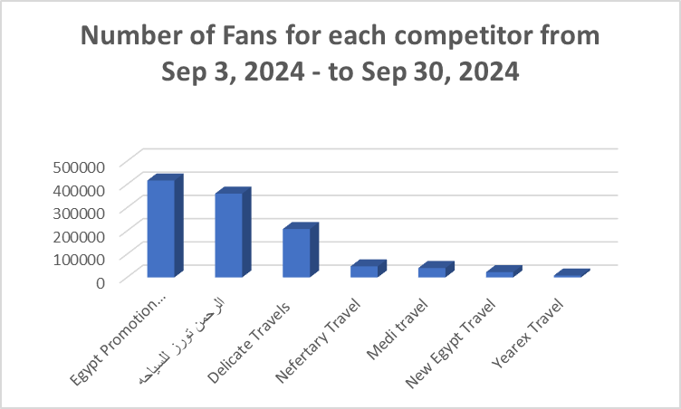
competitor analysis
Profile | Fans
Egypt Promotion Travel | 416735
الرحمن تورز للسياحه | 360343
Delicate Travels | 208006
Nefertary Travel | 47529
Medi travel | 40615
New Egypt Travel | 22888
Yearex Travel | 8237

Slide 20
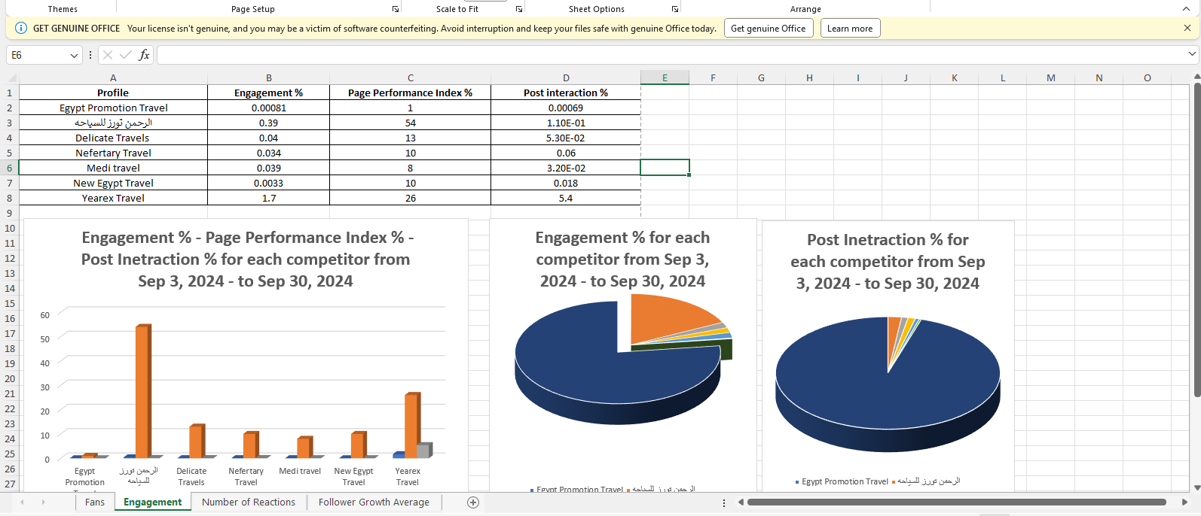
competitor analysis

Slide 21
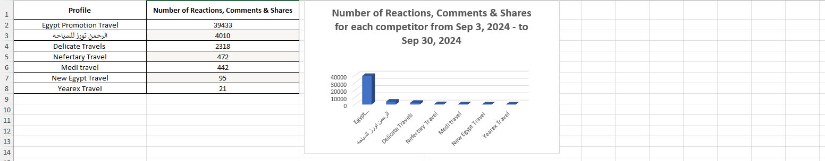
competitor analysis

Slide 22
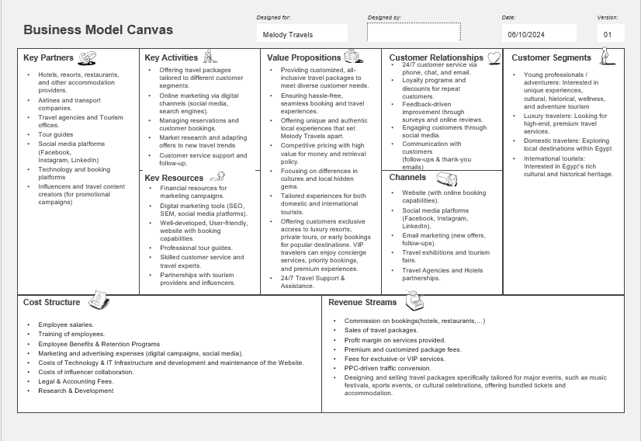

Slide 23
Melody Travel: Social Media Advertising Budget (3 Months)
Budget Item | Channel | Month 1 ($) | Month 2 ($) | Month 3 ($)
Social Media Ads | Facebook | 500 | 500 | 600
Social Media Ads | Instagram | 400 | 500 | 600
Social Media Ads | TikTok | 300 | 400 | 500
Email Marketing Campaigns | E-Marketing | 200 | 250 | 300
Social Media Ads | LinkedIn | 150 | 200 | 250
Influencer Collaborations | Instagram & TikTok | 400 | 500 | 500
Content Creation (Videos, Graphics) | All Channels | 300 | 350 | 400

Slide 24
Melody Travel: Social Media Advertising Budget (3 Months)
Month | Total Budget ($)
Month 1 | $2,250
Month 2 | $2,700
Month 3 | $3,150
Total Budget Per Month

Slide 25
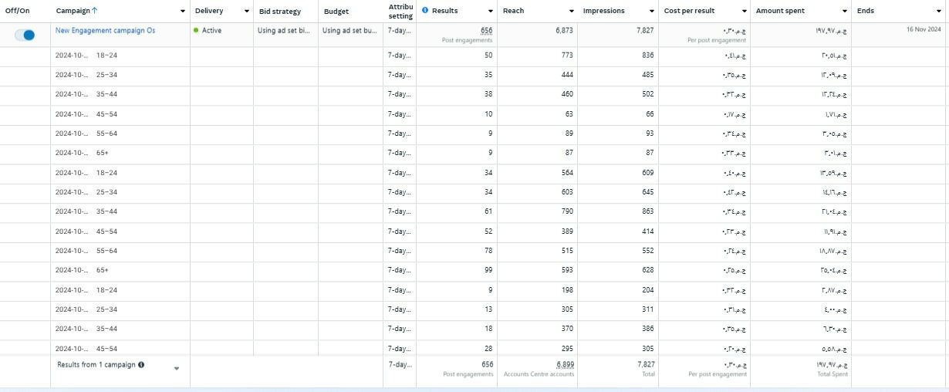
Campaign path on social media

Slide 26

our team
Ahmed Osama
Adel Mohamed
Alaa Abdo
Ahmed Gomaa
Ahlam mahmoud

Slide 27

Reach out to us for any questions.
EMAIL
Melody Travels @gmailcom
SOCIAL MEDIA
facecook@Melody Travels
instagram@Melody Travels
CALL US
+02-123-456-7890

